Slide 1
The Windy City is tired of crime and they need “Arrest” (and the ability to predict them)
Analysis of Crime Statistics from
Chicago’s Data Portal in 2018
Gil Graybill – UNCW Business Analytics Masters Program
BAN 502- February 22, 2020

Slide 2

The Big Questions
What if you could predict the chances that an arrest will be made?
Are some crimes more likely to lead to an arrest or go unsolved?
Do arrest rates vary by where and when the crime is committed?
With data provided by the City’s Data portal, we have the ability to create a model that can predict the changes of an arrest being made, given such factors as the crime that was committed, where is was committed (by Beat, District, Community Area, Ward), the time of day, the month of the year, and much more.

Slide 3
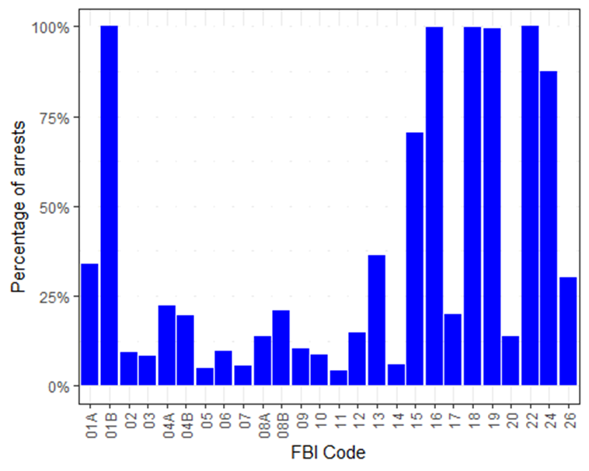
One strong predictor for arrest rate appears to be the type of crime that was committed (classified by FBI Code)

Slide 4
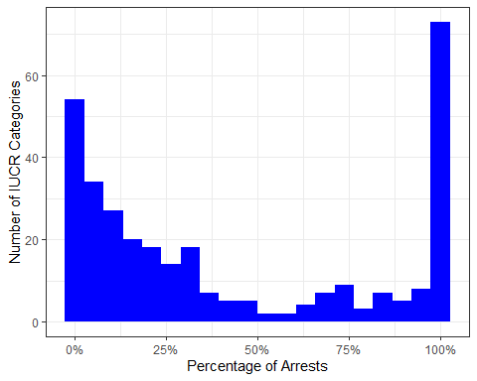
For some of the 322 IUCR Codes, the arrest rate is can be almost 0%. For others it’s 100%

Slide 5
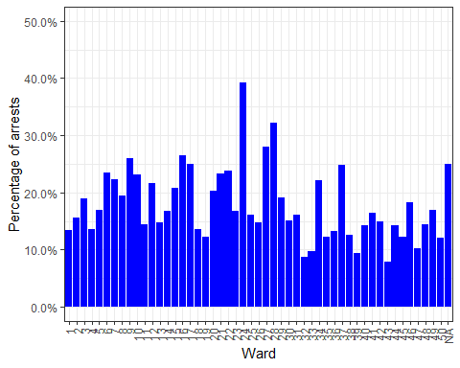
Arrest rates per ward can vary from 7.8% to 39%

Slide 6
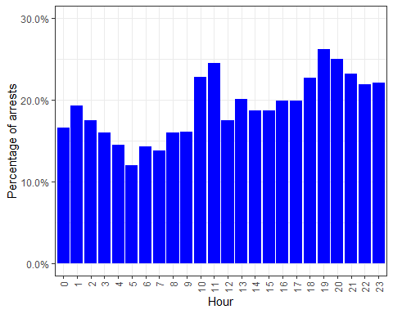
Time’s Up! Arrest rates can vary from between 12% and 26% based on the time that the crime occurs.
There does not seem to big difference in the arrest rate between months (Min is 19%, Max is 22%, not shown)

Slide 7

Additional Statistics
Domestic crimes arrest rate is 17.4%
Overall arrest rate is 20%
Arrest rate by Community Area is as low as 6.1% and as high as 50%
Arrest rate by Beat is as low as 4.7% and as high as 52%
Final Thoughts
Further analysis will let us develop a model to determine if there are any noteworthy interactions between these variables.
After a model is developed, resources can be reassigned to maximize arrests, cut costs, or implement strategic objectives.

